Slide 1
STRUCTURES
Introduction to C++

Slide 2
Abstract Data Types
A data type that specifies
  values that can be stored
  operations that can be done on the values
User of an abstract data type does not need to know the implementation of the data type, e.g., how the data is stored
ADTs are created by programmers
11-<number>

Slide 3
Abstraction and Data Types
Abstraction: a definition that captures general characteristics without details
  Ex: An abstract triangle is a 3-sided polygon. A specific triangle may be scalene, isosceles, or equilateral
Data Type defines the values that can be stored in a variable and the operations that can be performed on it
11-<number>

Slide 4
Combining Data into Structures
Structure: C++ construct that allows multiple variables to be grouped together
General Format:
  struct <structName>
  {
  type1 field1;
  type2 field2;
  . . .
  };
11-<number>

Slide 5
Example struct Declaration
  struct Student
  {
  int studentID;
  string name;
  short yearInSchool;
  double gpa;
  };
structure tag
structure members
11-<number>

Slide 6
struct Declaration Notes
Must have ; after closing }
struct names commonly begin with uppercase letter
Multiple fields of same type can be in comma-separated list:
  string name,
  address;
11-<number>

Slide 7
Defining Variables
struct declaration does not allocate memory or create variables
To define variables, use structure tag as type name:
  Student bill;
bill
studentID
name
yearInSchool
gpa
11-<number>

Slide 8
Accessing Structure Members
Use the dot (.) operator to refer to members of struct variables:
  cin >> stu1.studentID;
  getline(cin, stu1.name);
  stu1.gpa = 3.75;
Member variables can be used in any manner appropriate for their data type
11-<number>

Slide 9
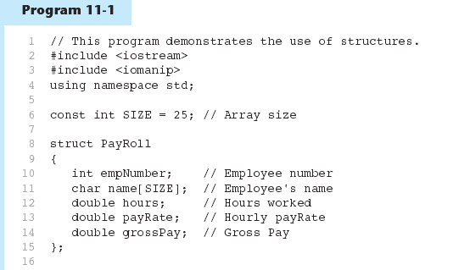
11-<number>

Slide 10
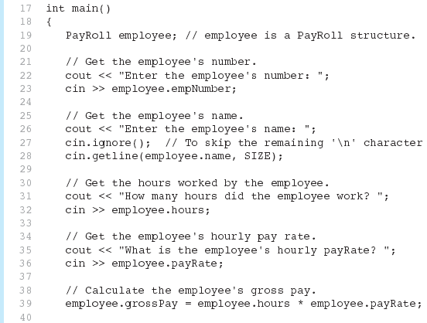
Program11-1 (Continued)
11-<number>

Slide 11
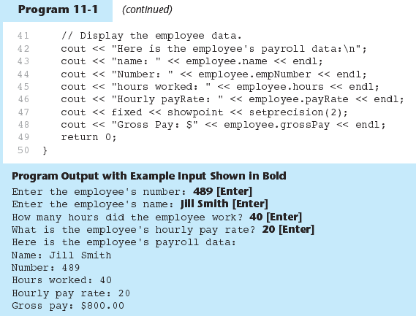
11-<number>

Slide 12
Displaying a struct Variable
To display the contents of a struct variable, must display each field separately, using the dot operator:
  cout << bill; // won’t work
  cout << bill.studentID << endl;
  cout << bill.name << endl;
  cout << bill.yearInSchool;
  cout << " " << bill.gpa;
11-<number>

Slide 13
Comparing struct Variables
Cannot compare struct variables directly:
  if (bill == william) // won’t work
Instead, must compare on a field basis:
  if (bill.studentID ==
  william.studentID) ...
11-<number>

Slide 14
Initializing a Structure
struct variable can be initialized when defined:
  Student s = {11465, "Joan", 2, 3.75};
Can also be initialized member-by-member after definition:
  s.name = "Joan";
  s.gpa = 3.75;
11-<number>

Slide 15
More on Initializing a Structure
May initialize only some members:
  Student bill = {14579};
Cannot skip over members:
  Student s = {1234, "John", ,
  2.83}; // illegal
Cannot initialize in the structure declaration, since this does not allocate memory
11-<number>

Slide 16
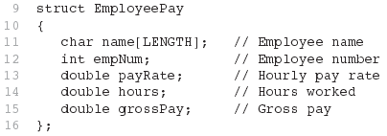
Excerpts From Program 11-4
11-<number>

Slide 17
Arrays of Structures
Structures can be defined in arrays
Can be used in place of parallel arrays
const int NUM_STUDENTS = 20;
Student stuList[NUM_STUDENTS];
Individual structures accessible using subscript notation
Fields within structures accessible using dot notation:
  cout << stuList[5].studentID;
11-<number>

Slide 18
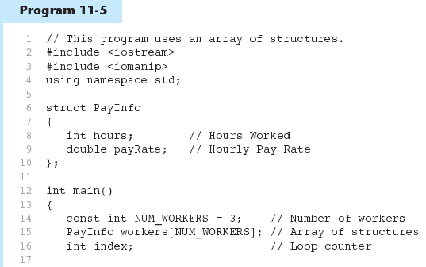
11-<number>

Slide 19
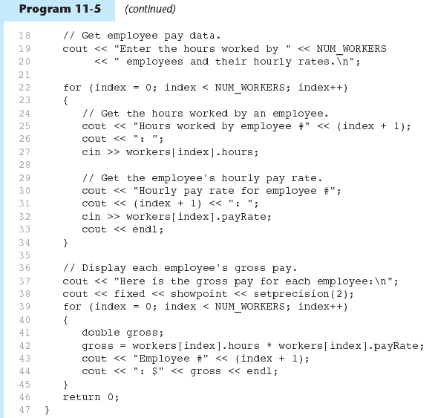
11-<number>

Slide 20
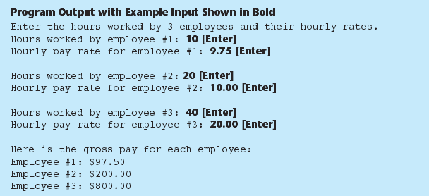
11-<number>

Slide 21
Structures as Function Arguments
May pass members of struct variables to functions:
  computeGPA(stu.gpa);
May pass entire struct variables to functions:
  showData(stu);
Can use reference parameter if function needs to modify contents of structure variable
11-<number>

Slide 22
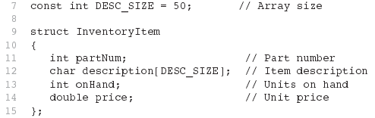
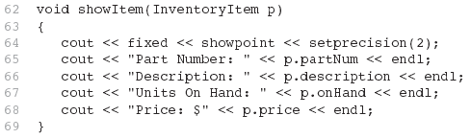
Excerpts from Program 11-7
11-<number>

Slide 23
Structures as Function Arguments - Notes
Using value parameter for structure can slow down a program, waste space
Using a reference parameter will speed up program, but function may change data in structure
Using a const reference parameter allows read-only access to reference parameter, does not waste space, speed
11-<number>

Slide 24
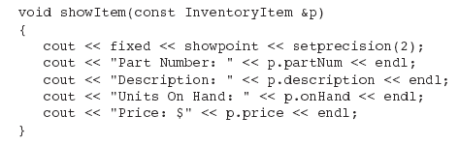
Revised showItem Function
11-<number>

Slide 25
Returning a Structure from a Function
Function can return a struct:
  Student getStudentData(); // prototype
  stu1 = getStudentData(); // call
Function must define a local structure
  for internal use
  for use with return statement
11-<number>

Slide 26
Returning a Structure from a Function - Example
  Student getStudentData()
  { Student tempStu;
  cin >> tempStu.studentID;
  getline(cin, tempStu.pData.name);
  getline(cin, tempStu.pData.address);
  getline(cin, tempStu.pData.city);
  cin >> tempStu.yearInSchool;
  cin >> tempStu.gpa;
  return tempStu;
  }
11-<number>

Slide 27
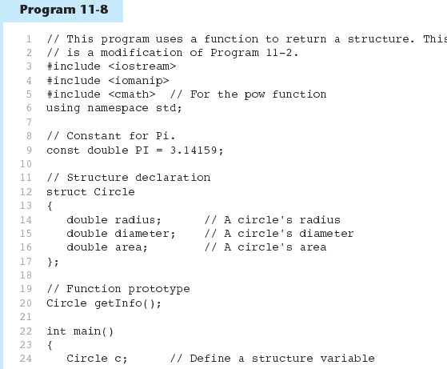
11-<number>

Slide 28
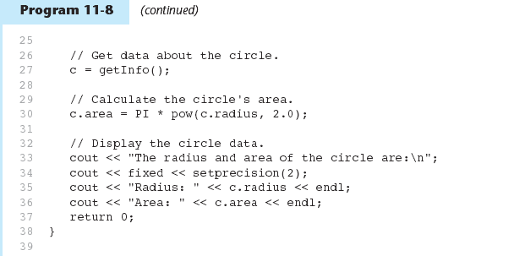
11-<number>

Slide 29
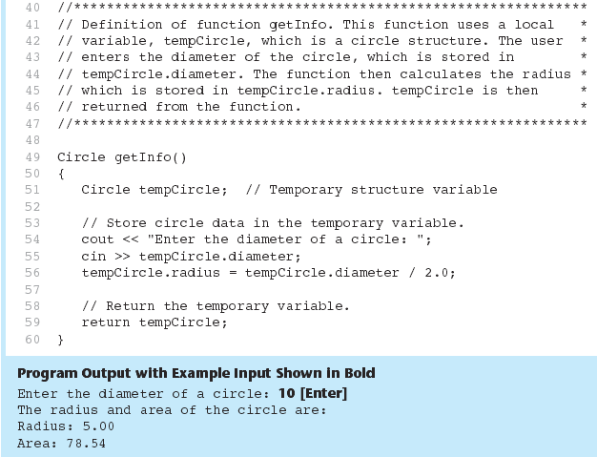
Program 11-8 (Continued)
11-<number>

Slide 30
Reading Homework
Gaddis Book : Read Chapter 11 Sections:
11.1—Abstract data types
11.2—Combining data into structures
11.3—Accessing structure members
11.4—Initializing a structure
11.5—Arrays of structure
11.7—Structures as function arguments
11.8—Returning a structure from a function
SKIP 11.9, 11.10, 11.11, 11.12
2-<number>

